Slide 1
Arguing Machines
Digital Artifactual Objections

Slide 2
The inequal distribution of power and wealth is driven to a great extent by intolerance
Intolerance is the inability of accepting each other
Acceptance requires understanding
Understanding is confined by your personal social character
The social character is so deeply coined by its development that we cannot see beyond it

Slide 3
Experimental Simulation on social dynamics
Exploring concepts of Hörensagen (hearsay)
information exchange and acceptance
prejudice

Slide 4
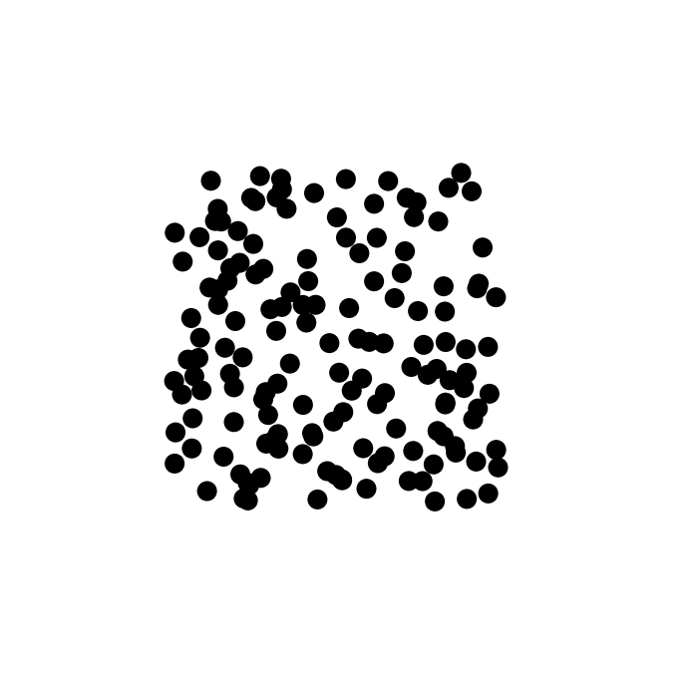
Experimental Simulation on social dynamics
t = 0 s

Slide 5
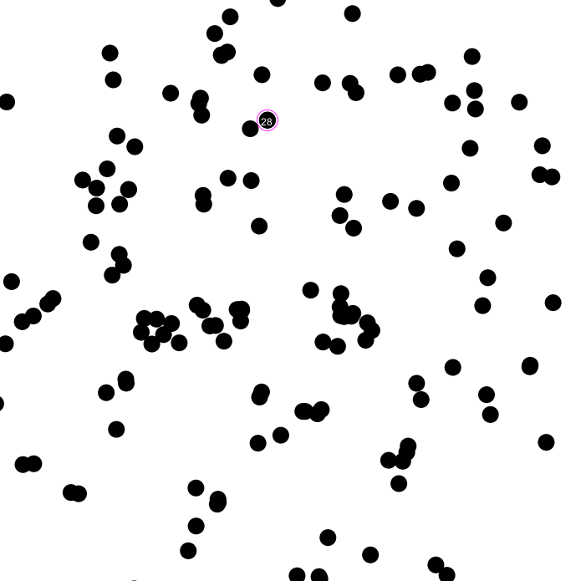
Experimental Simulation on social dynamics
t = 50 s

Slide 6
Experimental Simulation on social dynamics
t = 120 s

Slide 7
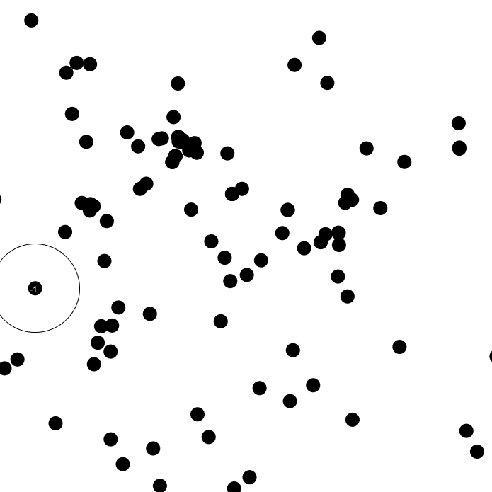
Experimental Simulation on social dynamics
t = 360 s

Slide 8
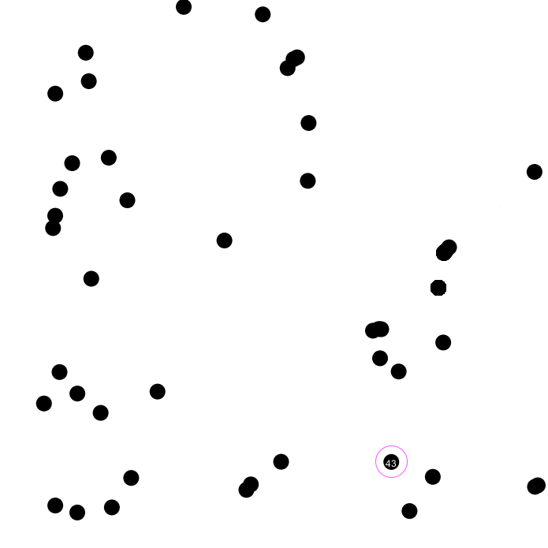
Experimental Simulation on social dynamics
t > 800 s

Slide 9
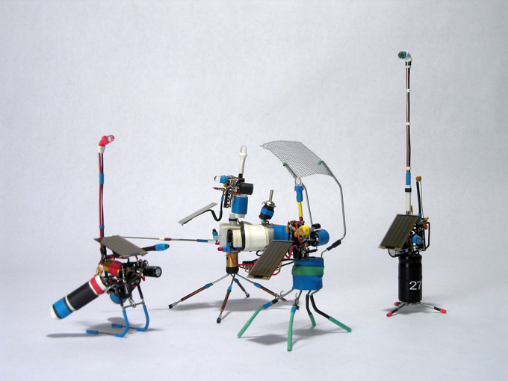
„Pummers“ by BEAM robotics - http://www.m27.com/projects/beam/

Slide 10
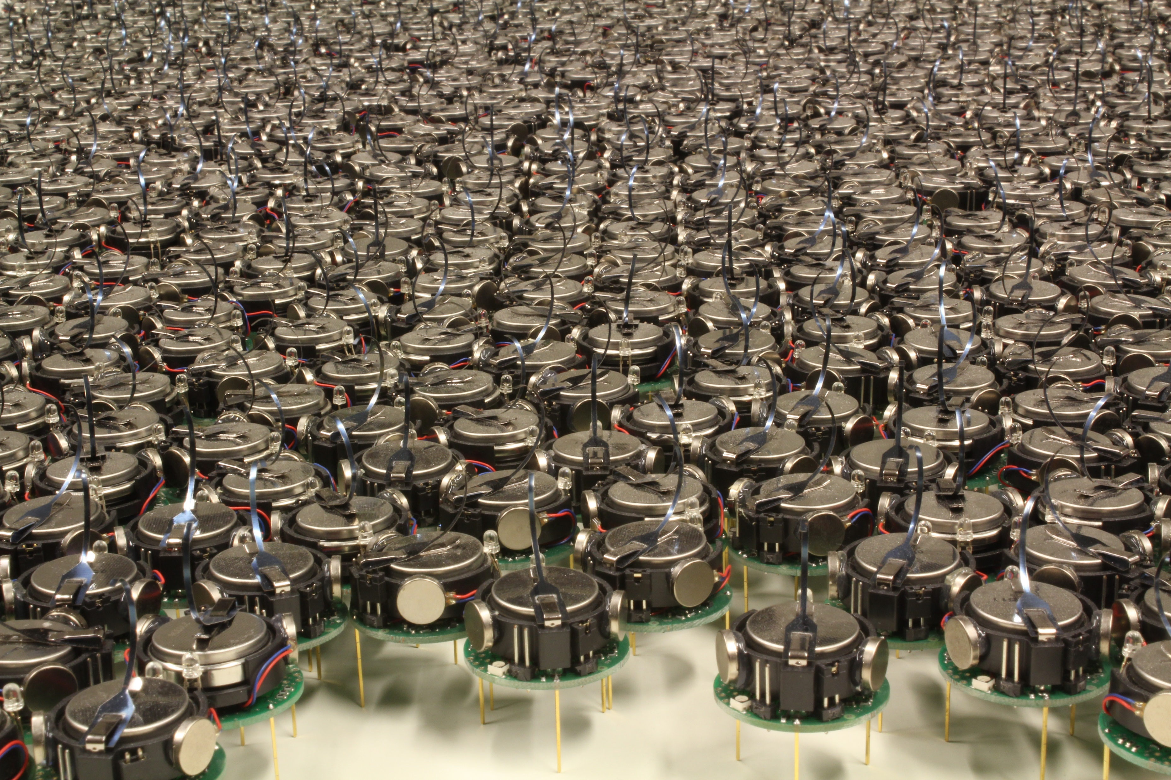

Slide 11
Installation: acoustically interacting robots
Capabilities:
emit sound
Frequency from closest db entry
(randomly? Time-based?)
receive sound
record frequencies
to an own database (as integers) and compare to existing entries
react to acoustic input
-> move randomly, stop only upon sound input
-> sound exchange: static installation offers higher chances for group-specific vocabulary to be formed; setup less random

Slide 12
Achievements, Steps & milestones
Capabilities:
emit sound
receive sound
record frequencies
react
Sound Out
Oscillators: Schmitt Trigger/DigiPot
Sound In
Signal Amplification
Decent Mics
Signal Reception
Signal Resolution, Noise Reduction -> Receptivity
Data Processing
Freq. Detection -> integer comparison, database, storage??
Reaction
Movement, Color, Sound/Vocabulary
Object Design

Slide 13
Plan B
…will be a sophisticated simulation of the social dynamics by data transfer with neighbours
displayed on big screens, comprehensively designed, …

